Slide 1
Bianca Kramer - Sesame Open Science
OPEN RESEARCH
INFORMATION
importance for research evaluation
ІІI International Conference - Open Science and Innovation in Ukraine 2024

Slide 2
Research evaluation - the why
Why?
Allocation of research budgets
Decisions on hiring, promotion and tenure
University reputation
Align assessment practices with the core values of the institution and the system as a whole
What kind of institutions do universities want to be ?

Slide 3
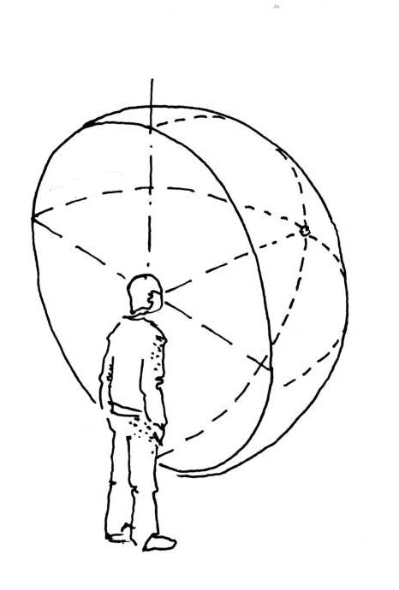
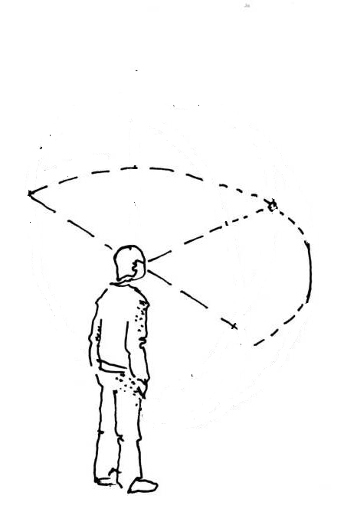
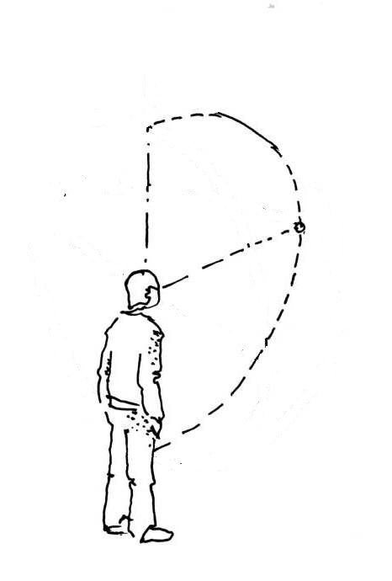
Research evaluation - perspectives
What - broadening and deepening
image adapted from 03-perspective sphérique

Slide 4
Research evaluation - perspectives
How - the lenses we use
image adapted from 03-perspective sphérique

Slide 5
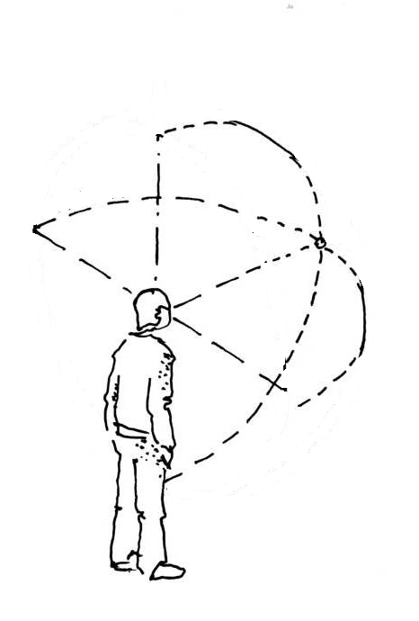
Research evaluation - perspectives
For the purposes of research assessment, consider the value and impact of all research outputs (including datasets and software) in addition to research publications Consider a broad range of impact measures including qualitative indicators of research impact, such as influence on policy and practices

Slide 6
Research evaluation - perspectives
Also look at research activities, not just research outcomes
linked to strategic goals (more formative assessment)
context-specific choices (accounting for disciplinary differences)
choices made collectively (at level of research groups, departments, faculties)
safeguarding good research practices

Slide 7
Choosing indicators - a balancing act
Relevant (context-dependent)
broader spectrum of activities, outputs and indicators
more agency for those being assessed
relevant
relevant
comparable
comparable
Comparable
comparable
relevant
comparable
relevant
more standardized requirements for outputs and metrics to be used

Slide 8
Choosing indicators - a balancing act
OPUS Research Assessment Framework (RAF)
comparable
Open Science Indicator Handbook
relevant
Open Science Assessment Framework (OSAF)

Slide 9
Research evaluation - perspectives
How - the lenses we use
Who do we give control over information on research outputs and impact ?
How open and inclusive are the data and infrastructure we use ?

Slide 10
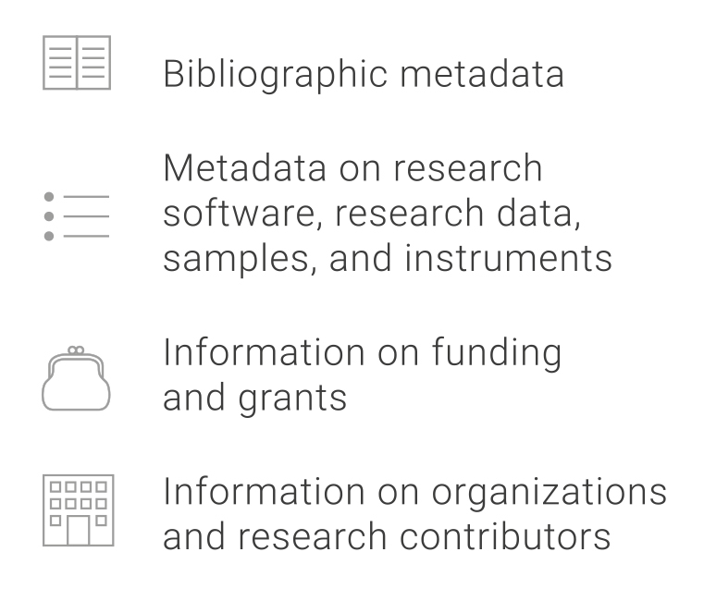
The importance of open research information
Research information: (bibliographic) metadata - including funding information and information on use and impact
Used in decision making around strategic priorities, distribution of resources, and evaluation of researchers and institutions
Used to assess the effect of policies (funders, institutions, government)
Used by researchers and societal stakeholders to find and assess research results

Slide 11
Research information must be open
Closed research information
Open research information
We are assessing researchers and institutions based on non-transparent evidence...
fair assessment requires
full transparency
We are making decisions based on information that is biased against less privileged languages, geographical regions, and research agendas...
equitable decision-making requires inclusive data
We are monitoring and incentivizing open science using closed data...
open science requires
open research information

Slide 12
UNESCO Recommendation on Open Science
“The monitoring of open science should be explicitly kept under public oversight, including the scientific community, and whenever possible supported by open non-proprietary and transparent infrastructures”

Slide 13
Coalition for Advancing Research Assessment
“Ensure independence and transparency of the data, infrastructure and criteria necessary for research assessment and for determining research impacts”

Slide 14
barcelona-declaration.org

Slide 15
Barcelona Declaration - Commitments
As organizations that carry out, fund, and evaluate research, we commit to the following:
1
We will make openness the default for the research information
we use and produce
2
We will work with services and systems that support
and enable open research information

Slide 16
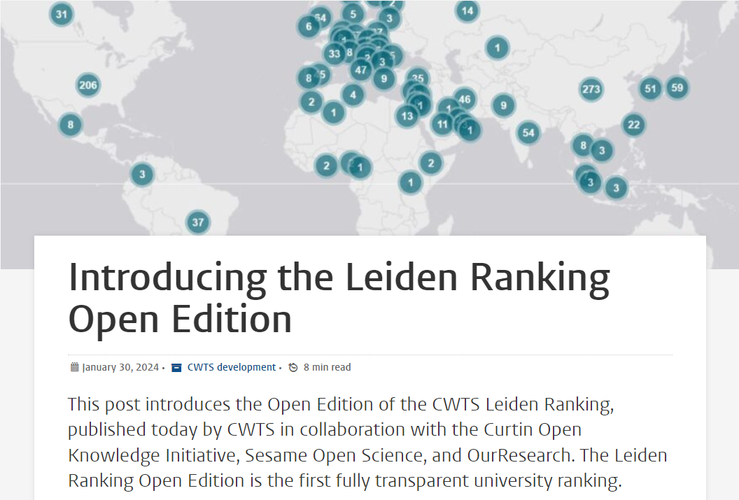
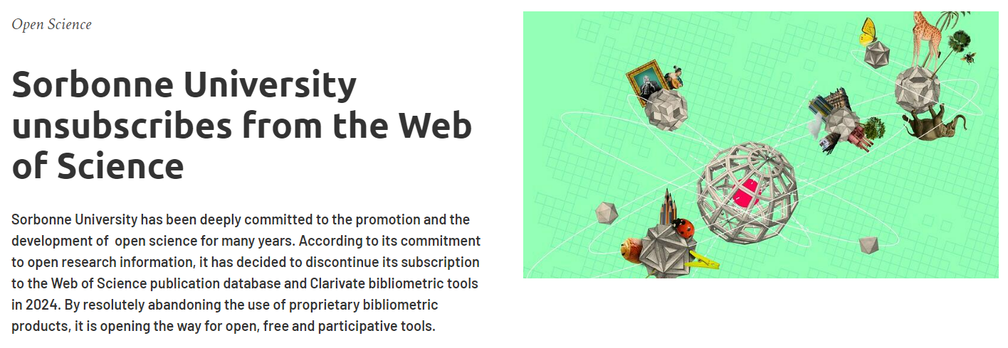
Examples

Slide 17
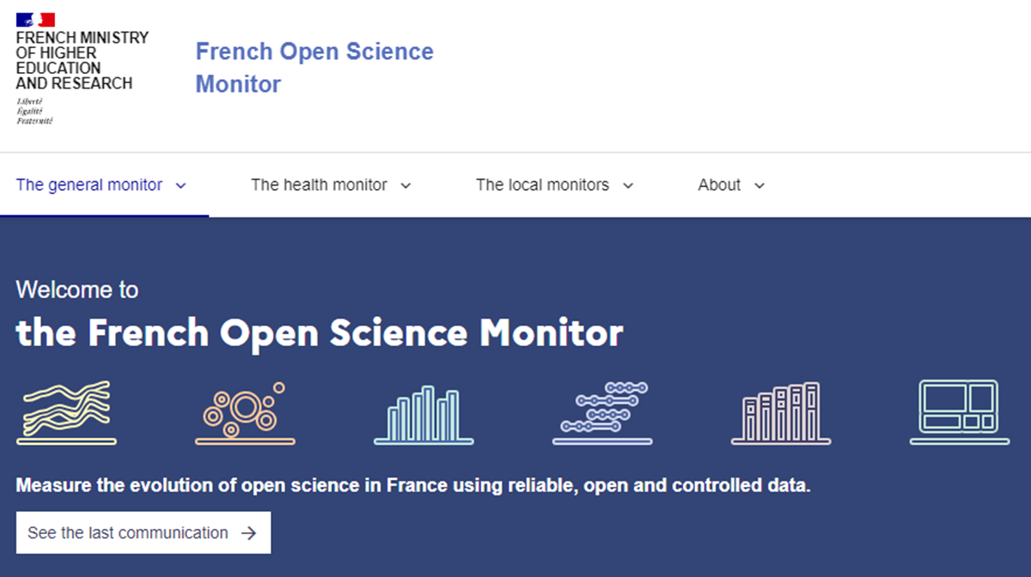
Examples

Slide 18
Barcelona Declaration - Commitments
As organizations that carry out, fund, and evaluate research, we commit to the following:
1
We will make openness the default for the research information
we use and produce
2
We will work with services and systems that support
and enable open research information

Slide 19
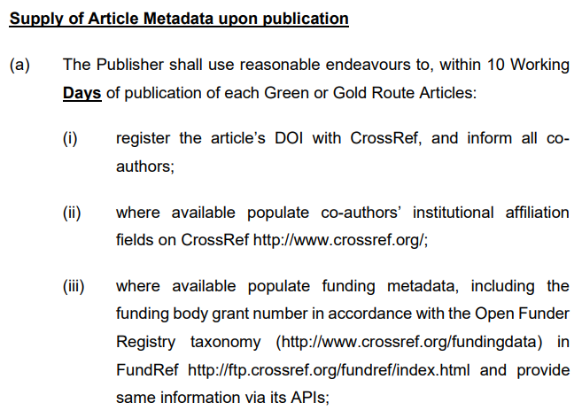
Openness of metadata in publisher agreements

Slide 20
Barcelona Declaration - Commitments
As organizations that carry out, fund, and evaluate research, we commit to the following:
3
We will support the sustainability of infrastructures
for open research information
4
We will support collective action to accelerate the transition
to openness of research information

Slide 21
Examples

Slide 22
Barcelona Declaration - Commitments
As organizations that carry out, fund, and evaluate research, we commit to the following:
3
We will support the sustainability of infrastructures
for open research information
4
We will support collective action to accelerate the transition
to openness of research information

Slide 23
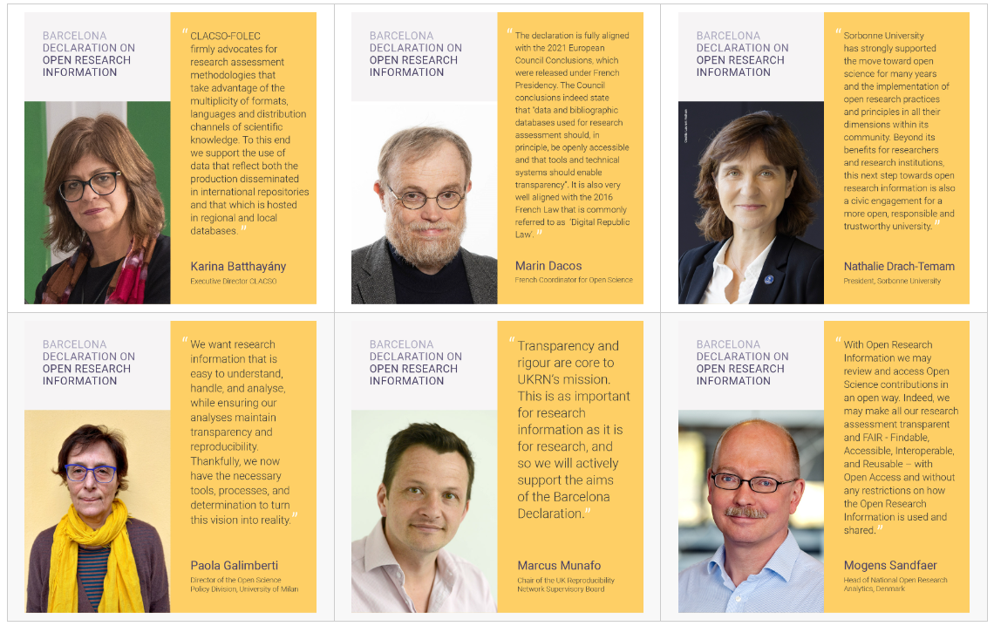
Barcelona Declaration - Signatories

Slide 24
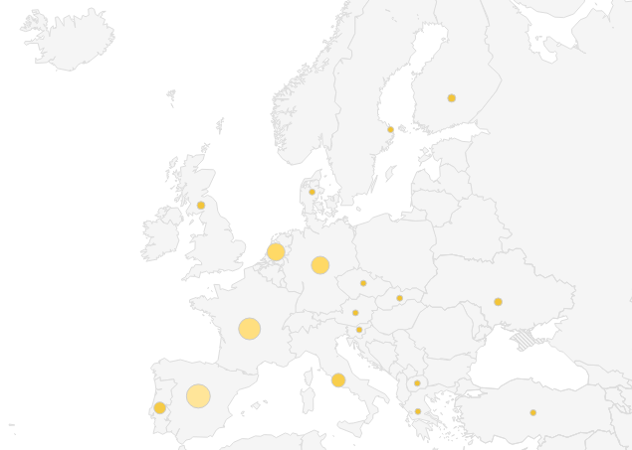
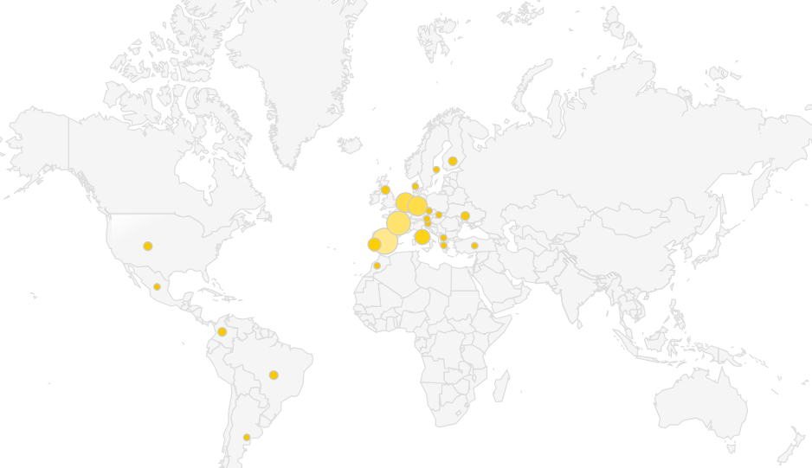
Signatories and supporters
As of today, the Barcelona Declaration has been formally signed by 89 organizations in 24 countries; among others, signatories include universities and other research institutions, research funders, and governments
Ukraine
State Scientific and Technical Library
Institute of Higher Education of the National Academy of Educational Sciences

Slide 25
Signatories and supporters
As of today, the Barcelona Declaration has been formally signed by 87 organizations in 24 countries; among others, signatories include universities and other research institutions, research funders, and governments
In addition, 44 organizations providing data, services and infrastructure are formal supporters of the Declaration
Many organizations have not yet signed the Declaration but have expressed an interest in contributing to the transition to open research information
As of today, the Barcelona Declaration has been formally signed by 87 organizations in 24 countries; among others, signatories include universities and other research institutions, research funders, and governments

Slide 27
Paris Conference
September 23-24, 2024 Sorbonne University
130 participants (on site and online)

Slide 28
Paris conference
Share information and experiences around adoption of open research information and implementation of the commitments
https://zenodo.org/communities/paris_conference_ori_2024
Develop an initial road map of next steps that need coordination and collaboration between signatories and supporters.

Slide 29
Collective actions
Journal article medata
IR / preprint / data repository metadata
Funding metadata
Replacing closed systems
Sustainability of infrastructures
Evaluating open data sources
Evidence of benefits
Metadata in CRIS systems
Data underlying rankings
Community curation
Journal article medata
IR / preprint / data repository metadata
Funding metadata
Replacing closed systems
Sustainability of infrastructures
Evaluating open data sources
Evidence of benefits

Slide 30
Get involved!

Slide 31
How to get involved?
Does your organization want to sign or support the Barcelona Declaration, or do you wish to know more?
Send us an email at contact@barcelona-declaration.org
For the latest updates, follow our social media channels:
LinkedIn: www.linkedin.com/company/barcelona-declaration/
Mastodon: mastodon.social/@BarcelonaDORI
X: x.com/BarcelonaDORI

Slide 32
The Barcelona Declaration on Open Research Information was prepared by a group of over 25 research information experts, representing organizations that carry out, fund, and evaluate research, as well as organizations that provide research information infrastructures. The group met in Barcelona in November 2023 in a workshop hosted by SIRIS Foundation. The preparation of the Declaration was coordinated by Bianca Kramer (Sesame Open Science), Cameron Neylon (Curtin Open Knowledge Initiative, Curtin University), and Ludo Waltman (Centre for Science and Technology Studies, Leiden University). Organizations that would like to know more about the Declaration or that wish to sign the Declaration are welcome to reach out to contact@barcelona-declaration.org

