Slide 1
How the Ukrainian community contributes to ORCID's Community Trust Network
ІІІ International Conference "Open Science and Innovation in Ukraine 2024" , October 2024
Paloma Marín-Arraiza, PhD, Associate Director of Engagement, https://orcid.org/0000-0001-7460-7794 , p.arraiza@orcid.org

Slide 2
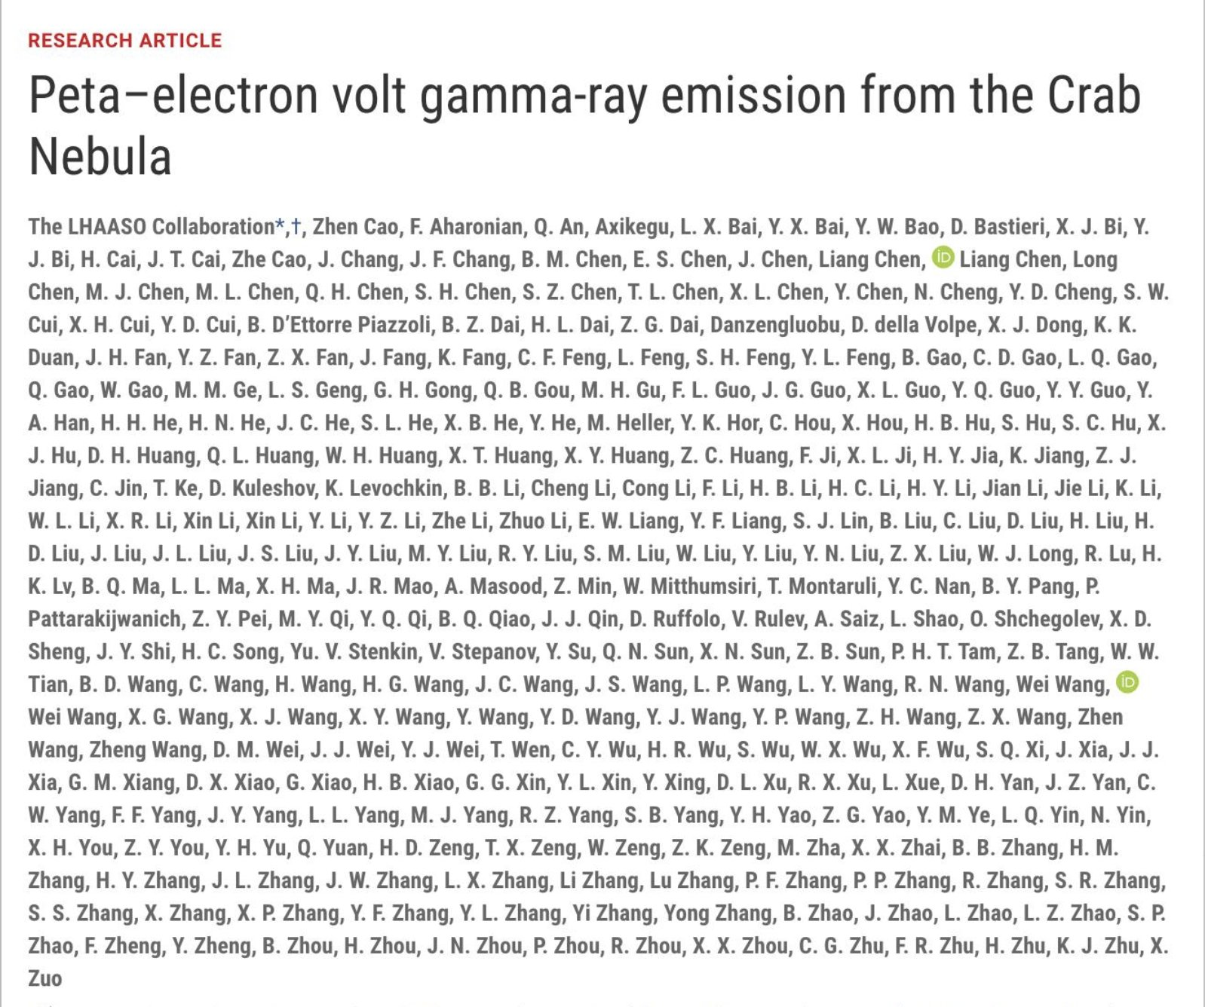
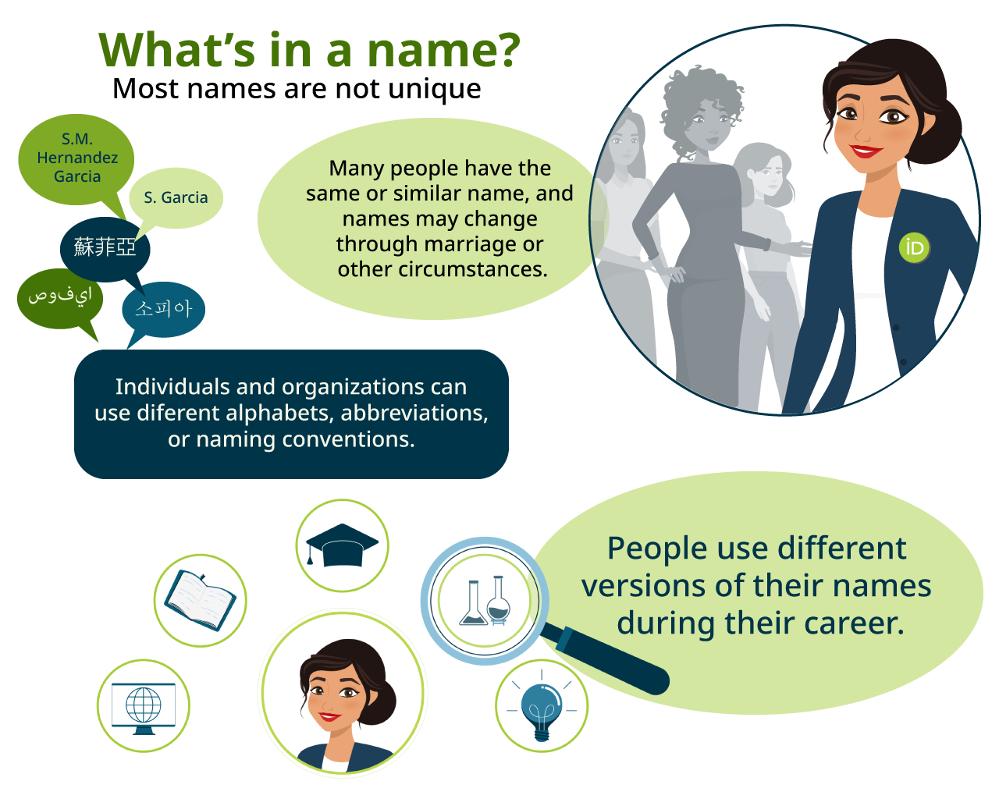
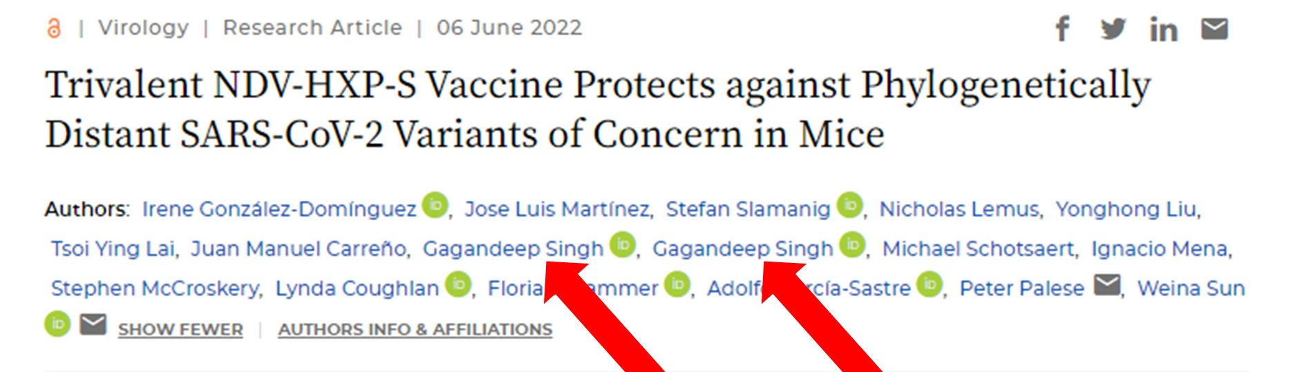
The ability to uniquely identify researchers is critical to a trustworthy scholarly record

Slide 3
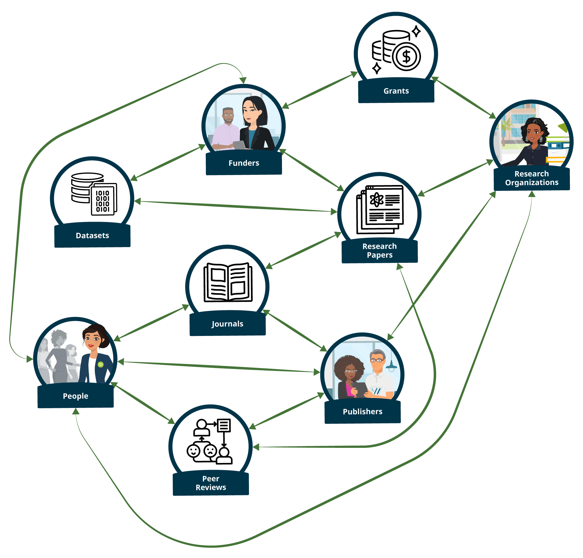
PIDs such as ORCID IDs are essential to tracking and analyzing the key relationships between the entities of research
The track record of researchers can be considered through previous works, peer reviews and funding awards
Affiliations between researchers and their institutions and be validated
Networks of bad actors can be visualized and analyzed:
Paper Mills
Citation rings
Corrupt editors/guest editors/editorial boards

Slide 4
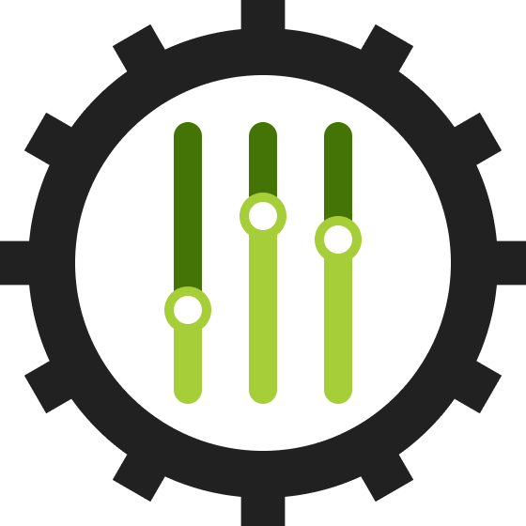
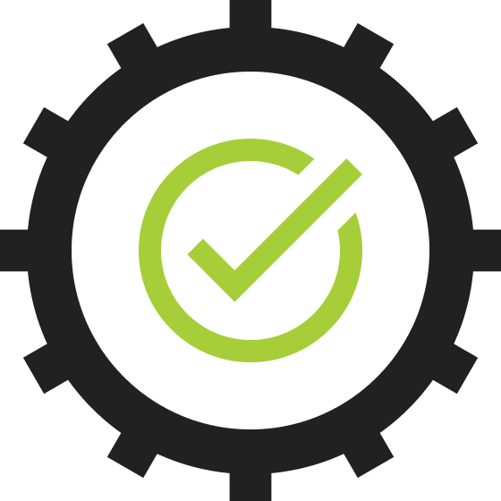
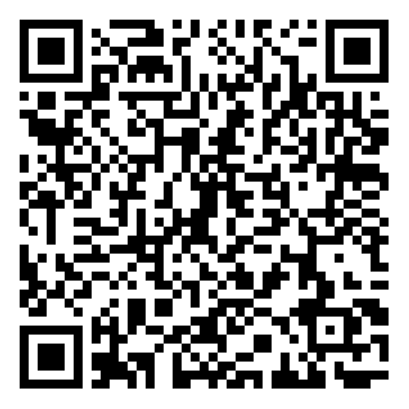
We aim to balance researcher control and data quality
https://info.orcid.org/balancing-researcher-control-and-data-integrity/
Researcher control
Data quality
Researchers …
Own their own records
Control who accesses their information
May change access preferences at any time
Terms of use prevent misrepresentation
False data in records may be disputed by anyone in the community
Machine-learning algorithm detects obvious spam
Disputed and spam records are removed from use, pending correction or withdrawal
Organizations may only add information to ORCID records with the researcher’s permission, and may only update or delete information that was added by them
Trust in an ORCID record accumulates over time as reliable and trustworthy data sources add information (with the record holder’s permission)
Notes:
You can read more about all the ways we think about researcher control at the blog post linked on this slide, but the main ideas are that researchers own their own record and can control who accesses their information. This means that organizations may only add information to ORCID records once the researcher grants them permission to do so, and they can only update or remove information that was added by them. Researchers can change these preferences at any time directly from their record.
The fact that we’ve prioritized and kept our commitment to researcher control has helped us earn the trust and participation of researchers, which has in turn led to wider, more inclusive uptake of ORCID by researchers and organizations across the globe. This means we’ve become a broadly adopted, open repository of user-generated data, and of course the flip side of this is that inevitably some individuals who may not be considered by scholarly community to be legitimate researchers can add information to their records that may not be considered by others to be objectively true. This naturally invites scrutiny about the quality of ORCID’s data.
One of the mechanisms we have in place to help ensure high data quality is our terms of use, which prevent researchers from misrepresenting themselves. And we have dispute procedures by which anyone in the community can challenge what they feel to be false data in records.
With over 14 million records in the ORCID registry, it would be surprising if we didn’t have spam! A vast majority of the spam we find is link spam, while a nuisance, doesn’t affect records surfaced in authenticated workflows, as spammers don’t have any incentive to use their records to sign in or connect to legitimate scholarly services and systems. Even so, we understand why spam can cast doubt on the overall value and trustworthiness of ORCID. We work hard to constantly monitor for and “lock” suspected spam records, and we regularly run heuristics to detect spam records. We also take standard measures to limit spam from being created automatically by bots such as requiring completion of a CAPTCHA prior to record creation. We are pursuing Machine Learning approach to detecting spam, which is yielding very promising results. This will reduce the need for manual review and allow us to lock spam records on a more timely, continuous basis.
But possibly the most important factor contributing to the data quality in ORCID records is the distributed, accumulative trust model which allows reliable and trustworthy data sources to add information to an ORCID record. These lead to the “trust markers” that Chris is going to talk about in just a minute.

Slide 5
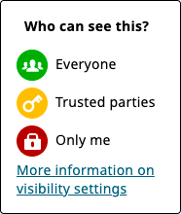
Researchers are in full control of their ORCID records
Data can only be added by the record holder themselves…
Fine-grained privacy controls let researchers control the visibility of each item in their record
…or, by an ORCID member organization, with the record holder’s permission
Notes:
Within this profile
Researchers set the visibility for each line-item in their ORCID profile from three options that are shown on the right,
Green/Public - which means openly available for everyone to see
Yellow/”Trusted Parties” - which means any organization the researcher has agreed to, can see & read their data, but it’s not publicly available
Third is the Red-”Only me” setting - which means this line item is only visible to the researcher.

Slide 6
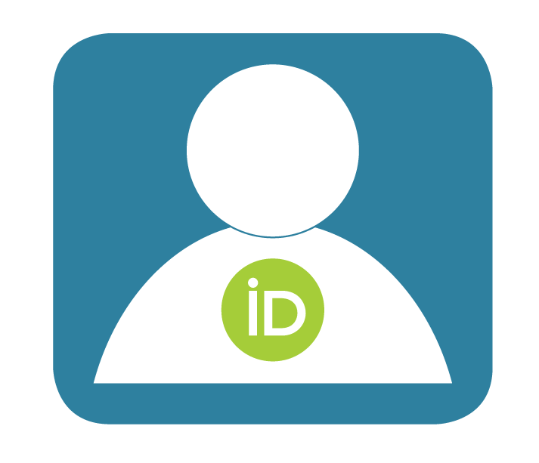
Researchers use ORCID in a variety of ways
For example, when submitting a manuscript or grant application, researchers may:
Sign into the submission system using their ORCID iD
Have their submission form pre-filled based on their ORCID record
Have their ORCID iD and their collaborators ORCID iDs included in the work metadata
Have their ORCID record automatically updated with the work once published
Notes:
What researchers are doing when they do any of these things, is they’re trying to demonstrate their identity.

Slide 7
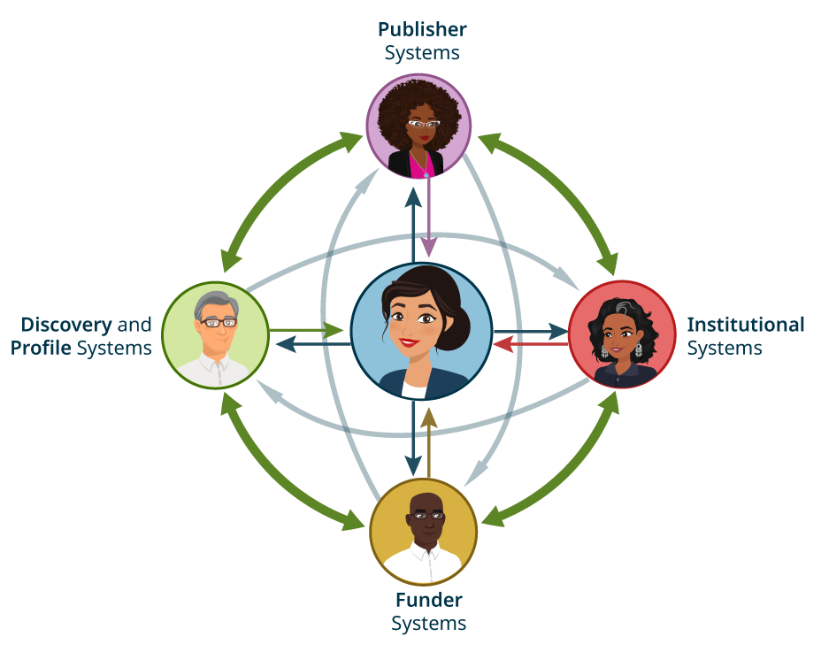
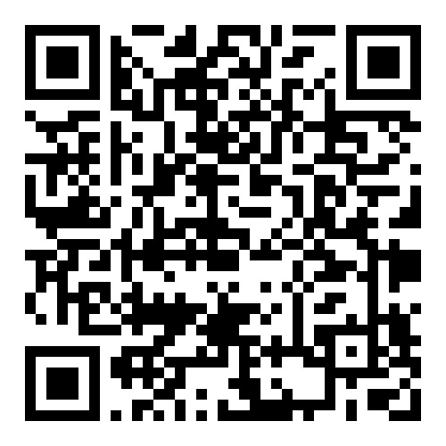
Think of ORCID as a hub of research-related data that gets propagated throughout scholarly systems
https://youtu.be/1Z7eR7Hnds0?si=ggxYHgTTPAHUEQ5e
The more fully-populated ORCID records and integrated systems there are, the more value that all stakeholders can gain from adopting ORCID.
Notes:
As Tom mentioned, “Community Trust Network” is our more evolved thinking around what we sometimes describe as our virtuous circle. It’s a pretty useful metaphor to show how the contents of an ORCID record might be reused throughout their careers.
Even though a lot of people refer to their ORCID records as a “profile,” the data in well-populated ORCID records can be re-used by the almost fifty seven hundred external tools and systems that are integrated with ORCID. So ORCID behaves more like a hub of re-usable profile data. And that data gets propagated throughout all those fifty-seven hundred scholarly systems that researchers interact with saving them huge amounts of time and effort. AND helping them demonstrate their identity through these trustworthy scholarly bona-fides that have been added by our members.
Now this example is really simplified. In reality it’s more complicated and involves other PID providers such as ROR that provides PIDs for organizations, and Datacite that provide DOIs for works or grant awards. You’ll notice a QR code at the bottom of this slide to a video recently published by OA Switchboard that helps explain how it works with all the organizations involved. It does a great job of explaining the process in detail, and I highly recommend you watch it.
This simplified diagram meant to convey that whatever data is in those records gets propagated throughout all the scholarly systems that those researchers interact with. Which is why it’s so important to us to help our members and other consumers of ORCID data understand more clearly the provenance of that data, because it depends on every organization in the community taking their share of ownership and responsibility for contributing the authoritative data that they hold about researchers in their corner of the research world.

Slide 8
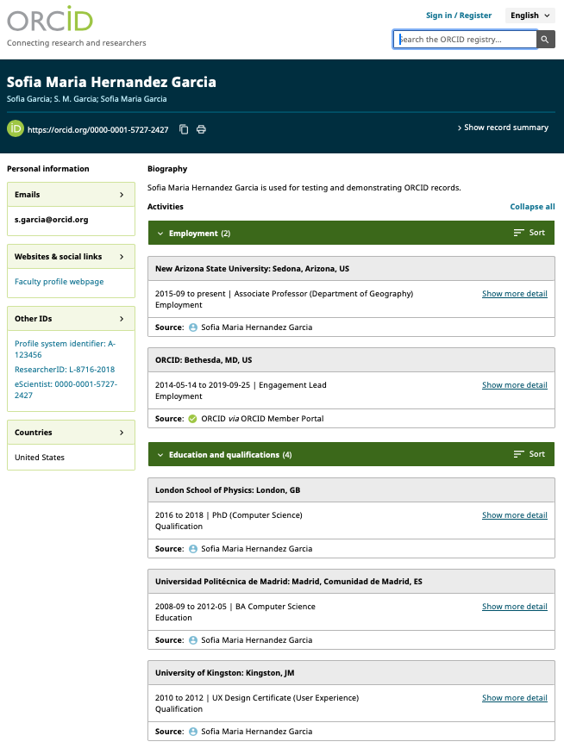
Information on ORCID records can help with decision making
Affiliations
Professional activities
Funding information
Publications
Other outputs
Peer reviews
Website URLs

Slide 9
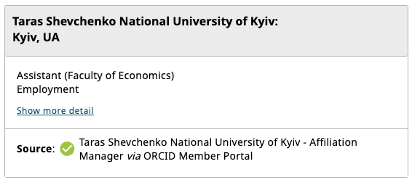
Validated information is even more useful
When an ORCID member organization updates an ORCID record, the source of that update is captured for re-use.
These provide ‘trust markers’ that can be used to help in decision making.

Slide 10
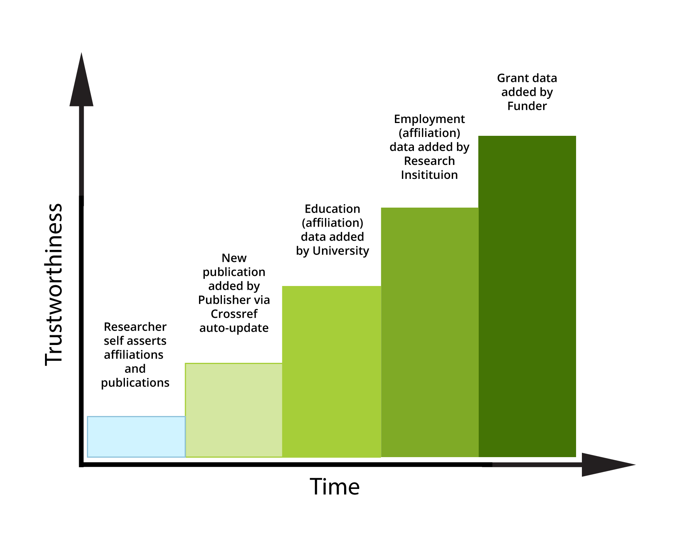
Each source of data has is own mechanisms to ensure trustworthiness
Can only be added by ORCID member organizations
Subject to membership agreement terms
Added via authenticated API
Data can be retracted by member
Collected via authenticated workflows
Community-monitored
Subject to dispute procedure
Record can be locked if not corrected
Notes:
And trust markers are present in the ORCID registry only because members add data to ORCID records, because only ORCID members are able to add data. This is by design. Though we are an open registry, meaning anyone can read or ingest data that has been made publicly available, but only ORGANIZATIONS, who have agreed to our membership terms of service, are able to contribute data.
However, we apply trust mechanisms to all data in the registry, not just the data contributed by members. As Chris mentioned earlier, our terms of use prevent misrepresentation and give us recourse to act when records are disputed by anyone in the community. We have a machine-learning algorithm that detects spam, and disputed records are removed from use, pending correction or withdrawal.
Remember, trust markers clarify the data’s provenance, and make it easier for consumers of that data to decide for themselves if it meets the requirements for their use case. And it’s meant reduce effort, giving an editor or grant reviewer less things to double check when assessing a researcher’s scholarly bona-fides during the submission process. In fact, a few of our members view it as their responsibility to contribute their data, since it helps researchers demonstrate their identity.
No matter how many trust markers are in the registry, there will always be self asserted data in ORCID records and there will always be perfectly good reasons why a researcher has to self-assert: perhaps the organization they are affiliated with doesn’t contribute data yet, or doesn’t exist in the same form anymore, or they’re recording an historical output.
Whatever the reason, ORCID is committed to making it as easy as possible for our members to contribute data to records, because…

Slide 11
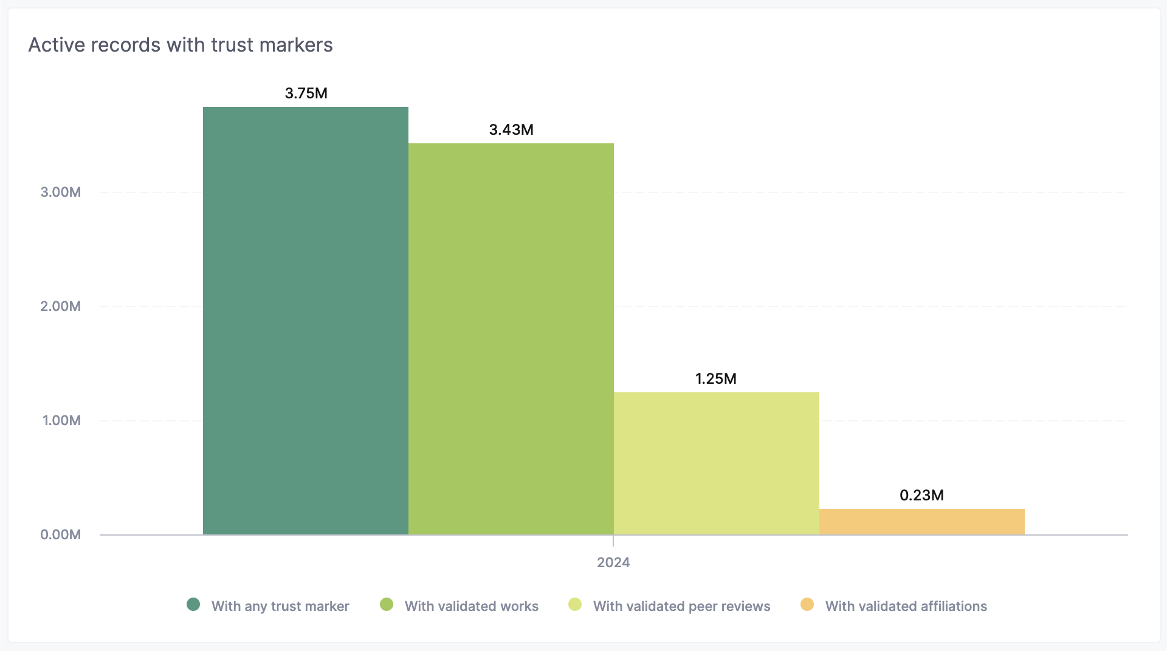
Trust markers are more common than you think
44% of active records have a trust marker
Notes:
That’s 44% of active records.

Slide 12
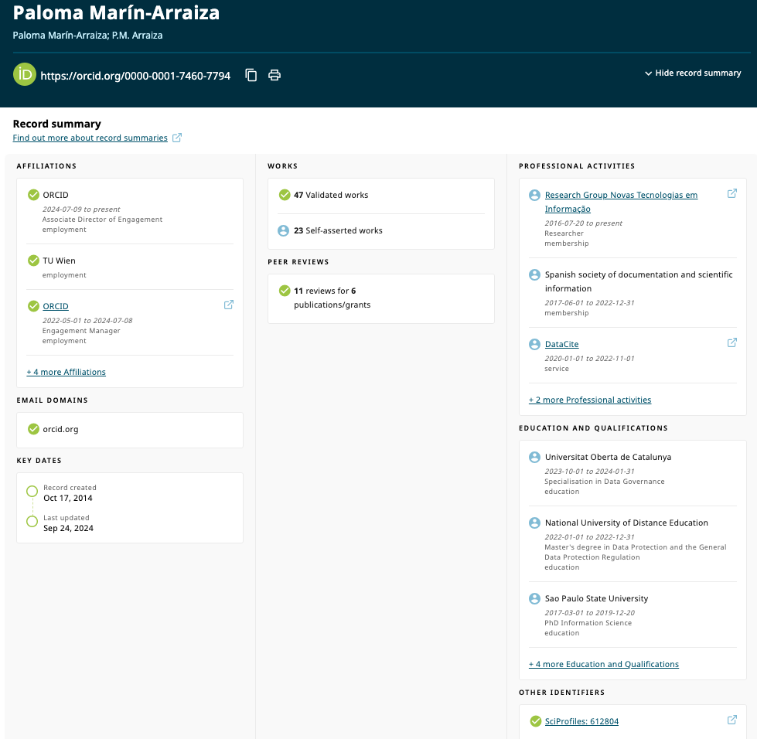
The Record Summary is available directly from ORCID records
Researchers can access a summary view of their own records, and see others’ Record Summaries

Slide 13
ORCID’s Members form our Community Trust Network
Notes:
As Chris said earlier, there is a growing concern about the loss of trust in the scholarly record from all sectors of the research community. And community crises require community commitment to adopting those solutions.

Slide 14
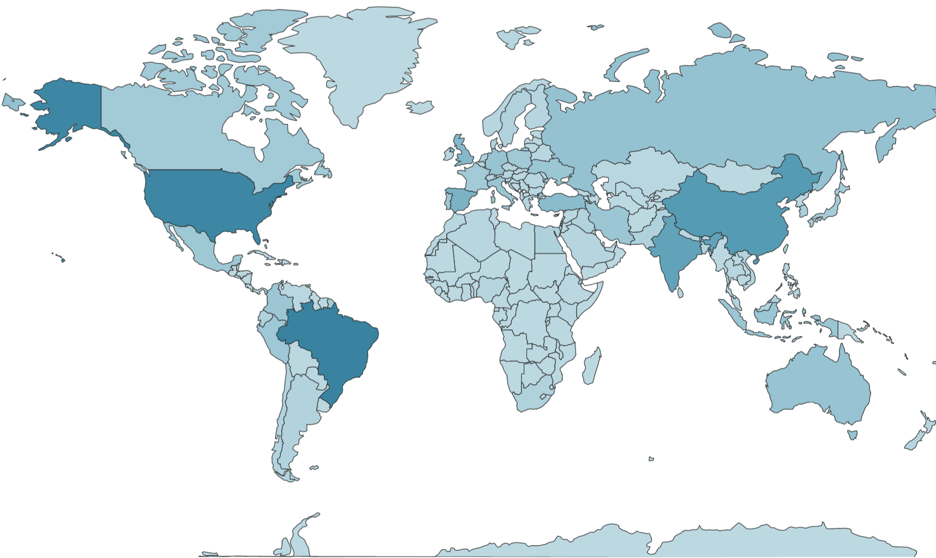
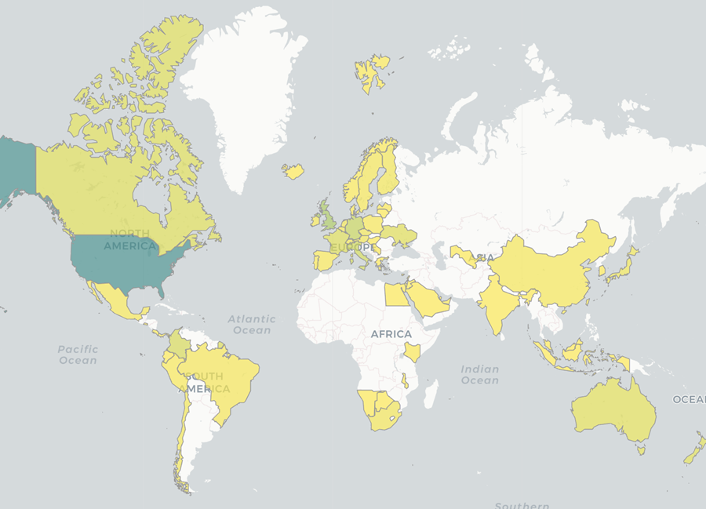
ORCID’s community trust network spans the globe
Data collected on 10 October 2024 More data available at https://info.orcid.org/orcid-statistics/
Users in 249 countries That’s every country on the planet!
Member organizations in 60 countries 28 national consortia and 1 regional consortium
Yearly Active Researchers
8.79 M
Active Integrated Systems
5,795
Organizational Members
1,410
Notes:
ORCID has researchers in every country in the world; that’s over 9 million researchers who are active in their records; meaning they have either signed into or updated their own records, or used their records to sign into another system in the last 365 days. As of today we have 5,598 active integrations, which means ORCID plays a critical role in connecting the ecosystem of scholarly information systems. That is the number of external systems that are integrated with ORCID that at least one researcher has either connected to or signed in using their ORCID ID in the last 365 days.
And though we have nearly 1400 members in 58 countries, you can see on the right hand map there are vast areas in the Global South that show an opportunity for wider organizational adoption. Now, we still have researchers in those areas, but because there aren’t currently organizations making connections to their researchers’ records those researchers are possibly deriving much less value from their records as compared to their colleagues in the global north.

Slide 15
How the Ukrainian community contributes to ORCID's Community Trust Network
Notes:
As Chris said earlier, there is a growing concern about the loss of trust in the scholarly record from all sectors of the research community. And community crises require community commitment to adopting those solutions.

Slide 16
The Ukrainian consortium actively contributes to ORCID records and metadata reuse

Slide 17
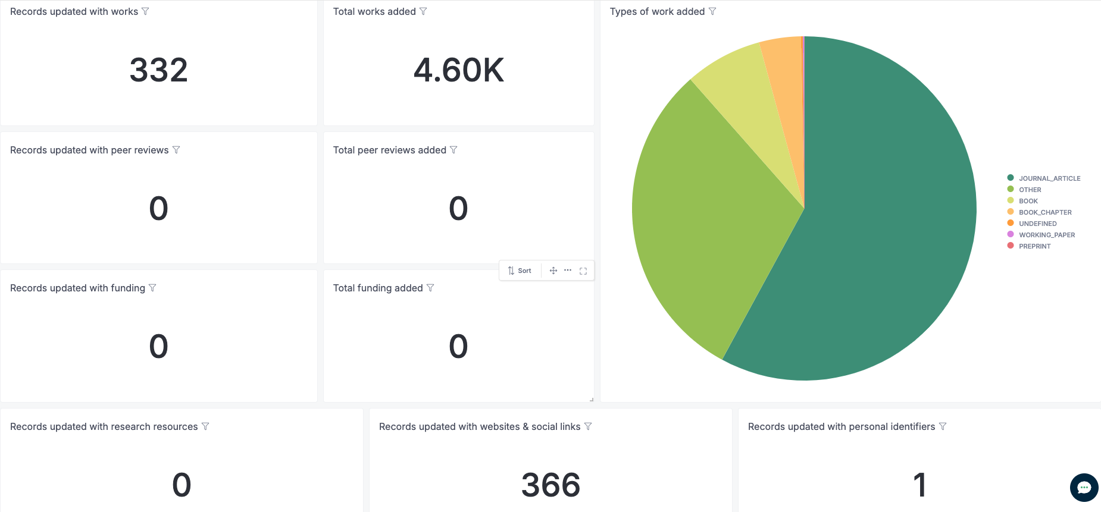
The Ukrainian consortium actively contributes to ORCID records and metadata reuse

Slide 18
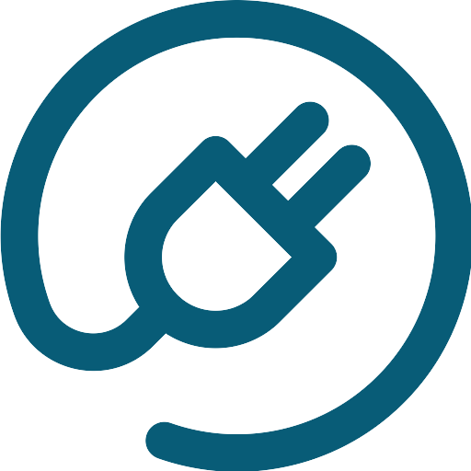
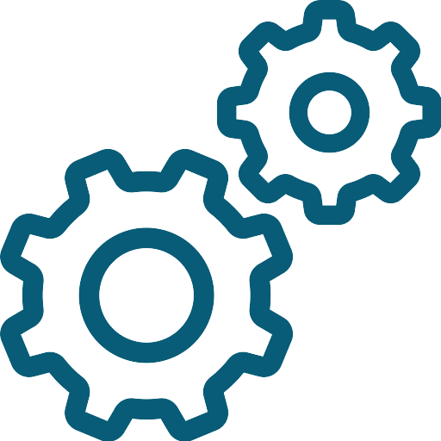
These contributions are possible via integrations
Certified service provider (e.g. OJS)
Custom integrations (for self-developed institutional systems, in progress for UCRIS)
Affiliation Manager (highly adopted in the country)
Documentation: https://info.orcid.org/documentation/integration-guide/
Certified service providers: https://info.orcid.org/vendors-and-service-providers/orcid-certified-service-providers-list/
Affiliation Manager: https://info.orcid.org/affiliation-manager/

Slide 19
This wouldn’t be possible without SSTL support
Notes:
As Chris said earlier, there is a growing concern about the loss of trust in the scholarly record from all sectors of the research community. And community crises require community commitment to adopting those solutions.

Slide 20
Thank you!
дякую!
ІІІ International Conference "Open Science and Innovation in Ukraine 2024" , October 2024
Paloma Marín-Arraiza, PhD, Associate Director of Engagement, https://orcid.org/0000-0001-7460-7794 , p.arraiza@orcid.org

