Slide 1
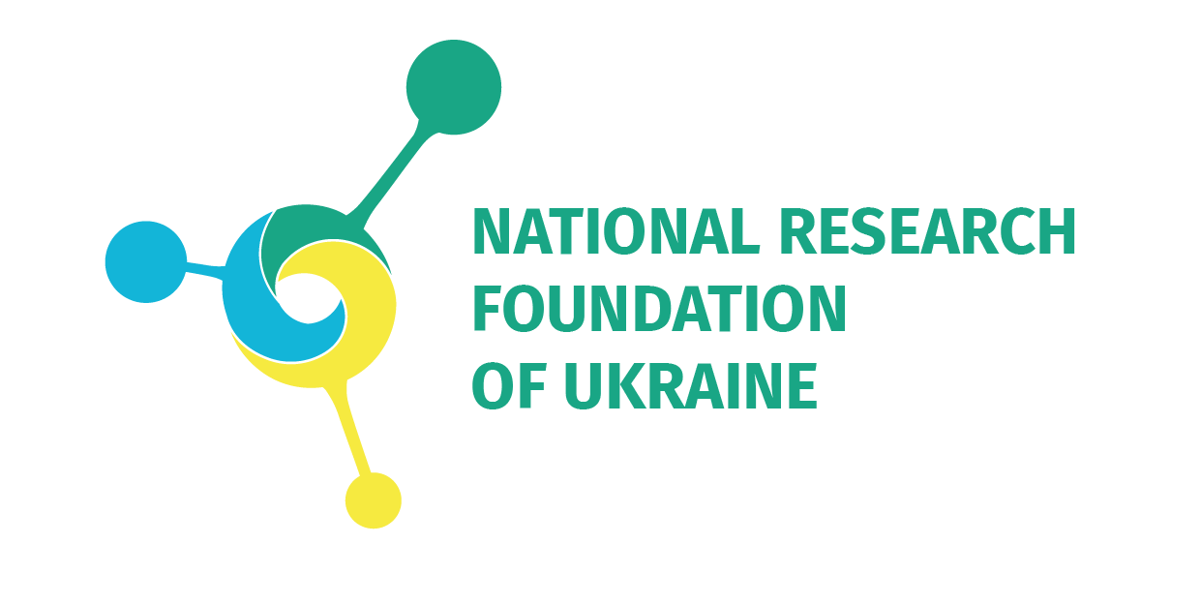
ІІІ International Conference
"Open Science and Innovation in Ukraine 2024"
#OSICU2024
Advancing CoARA principles in assessment of R&D projects submitted to the NRFU calls for proposals
Olga POLOTSKA
Executive Director of the National Research Foundation of Ukraine

Slide 2
The National Research Foundation of Ukraine (NRFU) is a special instrument for the implementation of state policy. The Foundation funds the activities aimed at the all-rounded development of Ukrainian research as a major factor in the economic growth of the state.
One of the main goals of the Foundation is the development of the national research area and its integration into the global research area. To achieve these goals, the Foundation cooperates with foreign research networks and environments, joins international initiatives, and exchanges best practices with foreign partners, including those related to Open Science.
2

Slide 3
The benefits of Open Science
for the NRFU:
improving the reliability and reproducibility of research results;
increasing the level of academic integrity;
increasing the impact of research on the development of science and society as a whole;
promoting national reform in the field of Open Science to modernize the research system in Ukraine and its European integration.
3

Slide 4
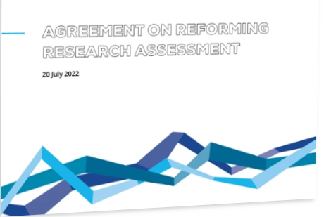
In 2022, the NRFU signed the Agreement on Reforming Research Assessment and became a member of the coalition CoARA.
The process of drafting the Agreement was initiated in January 2022. More than 350 organisations from over 40 countries were involved. Organisations involved included public and private research funders, universities, research centres, institutes and infrastructures, associations and alliances thereof, national and regional authorities, accreditation and evaluation agencies, learned societies and associations of researchers, and other relevant organisations, representing a broad diversity of views and perspectives.
4

Slide 5
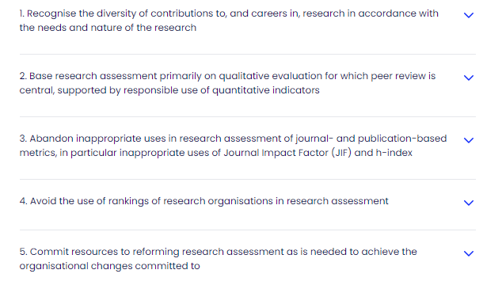
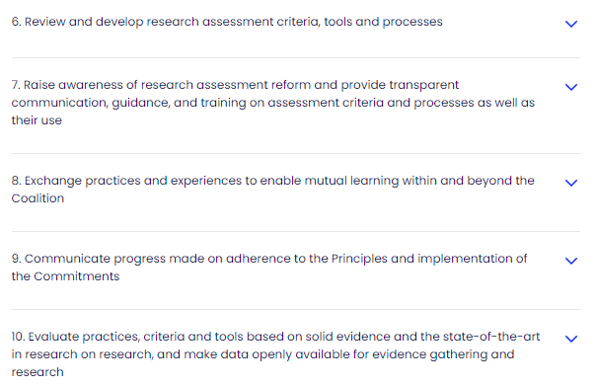
Key obligations of the Agreement
and principles of the CoARA
5

Slide 6
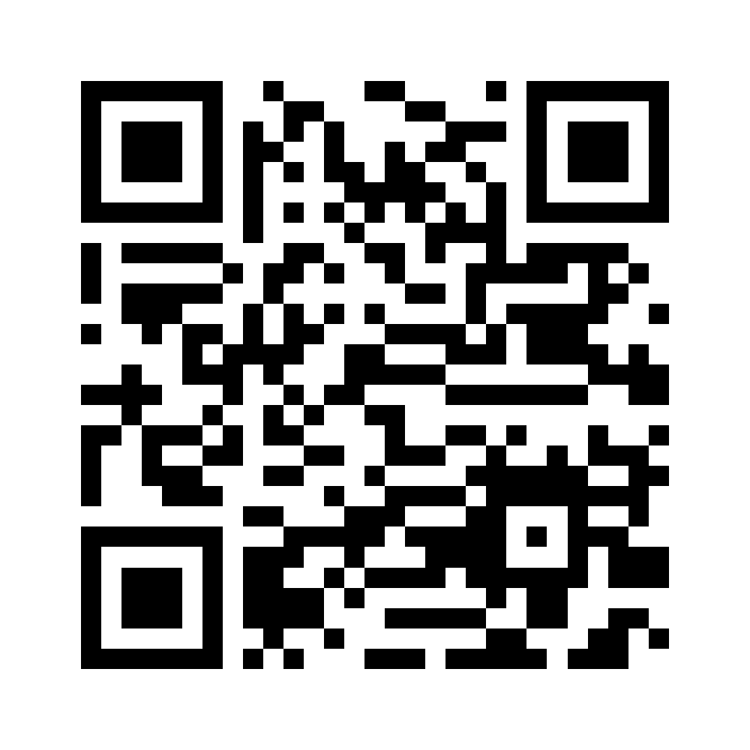
NRFU Action Plan Supporting CoARA
for 2024-2029
On July 11, 2024, the Scientific Council of the National Research Foundation of Ukraine approved the Action Plan Supporting CoARA for 2024-2029.
This plan is published on the international platform of the European Commission.
6

Slide 7
Advancing CoARA principles in the NRFU
Olga Polotska is the Co-Chair of the CoARA National Chapter of Ukraine;
representatives of the NRFU are members of the CoARA Working Group ‘Improving practices in the assessment of research proposals’;
the NRFU representatives are members of Working Groups of Science Europe: ‘SE Working Group on Science Communication', ‘SE Working Group on Open Science’;
the NRFU joins international communities, actively participates in international and national events and activities dedicated to Open Science;
stable contacts with European experts in Open Science have been established;
the NRFU is a member of the Open4UA Project Consortium and the MES Working Group on developing a methodology of assessing the effectiveness of scientific and technical activities of research institutions and higher education institutions.
7

Slide 8
Advancing CoARA principles in the NRFU
Since 2022, the terms and conditions of calls launched and administered by the NRFU have been formulated in accordance with the Agreement on Reforming Research Assessment (CoARA).
The NRFU uses an analog of Narrative CV (questionnairies for the PIs and project implementers).
The NRFU publishes all research reports of its grantees openly.
The NRFU supports publications in open-access journals at the expense its grants.
The NRFU provides for involvement of students and technical staff in projects.
The NRFU promotes the use of Centers for Collective Use of Scientific Equipment.
8

Slide 9
Open4UA project objectives:
fostering the National reform on Open Science for the higher education system modernisation and EU integration by supporting legislation amendments based on the orchestrated National consensus;
introducing existing advanced approaches and creating state-of-the-art recommendations and mechanisms to reform research assessment to prioritise Open Science at the National level during state certification of higher educational institutions and research projects evaluation;
fostering the institutional reform on Open Science and advancing research assessment in higher educational institutions through developing and piloting related toolkits.
9

Slide 10
Work package WP4: Prioritizing OS at the National level
Lead Beneficiary: NRFU
Objectives:
Сo-creating recommendations for the implementation of CoARA principles in the policies and practices of evaluating projects by National funders.
Developing and deploying the open database of projects funded by the NRFU.
Co-creating recommendations on the state certification of HEIs based on OS principles.
10

Slide 11
Next steps
Developing the Regulations on the Assessment of Quality and Effectiveness of R&D Project Results;
participation of the representatives of the Foundation in working groups on drafting legislation on the development of education and science;
dissemination of best practices by informing Ukrainian research community and national funders about the implementation of CoARA principles.
The Foundation’s vision is to ensure diverse contributions to research through the formation of sustainable, efficient, and effective national research communities.
11

Slide 12
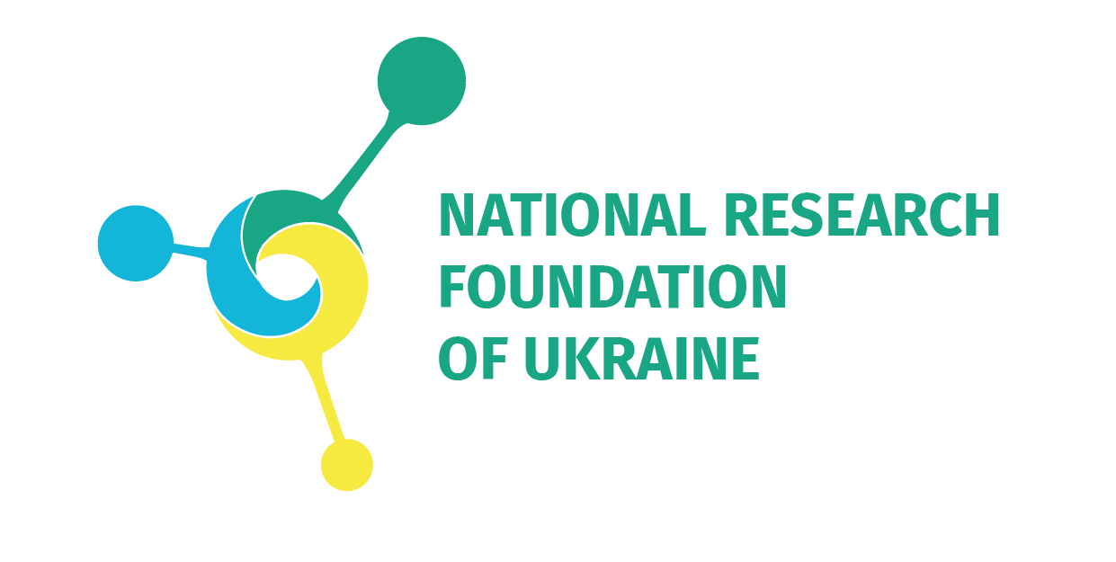
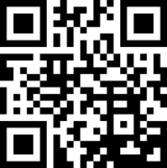
@UANRFU
@NRFUkraine
nrfu.org.ua
@PolotskaOO@nrfu.org.ua

